Slide 1
Recovery of Vertex Orderings in Dynamic Graphs
Wojceich Szpankowski
Purdue University
Notes:
Good afternoon all. I welcome the jury members and all others to my thesis defense. My name is Jithin K. Sreedharan. I am a PhD student in Inria, associated with Maestro team. The tile of the thesis is Sampling and Inference in Complex Networks.

Slide 2
Motivation
Node Age Recovery
Given a snapshot of a dynamic network,
can we recover the arrival order of nodes?
Or can we invert the arrival process ?
Twitter discussion of an Australian Labor Party leadership spill between 7 p.m. and midnight (AEST) on 23 June 2010

Slide 3
Motivation: Infection Spread

Slide 4



Motivation: Infection Spread (contd.)
Infection network
Nodes as patients, edges formed among friends and family.
Only structure info available. Patients admitted not at the order they got infected.
Identify early patients
Study mechanisms of transmission, connection to genetic origin

Slide 5
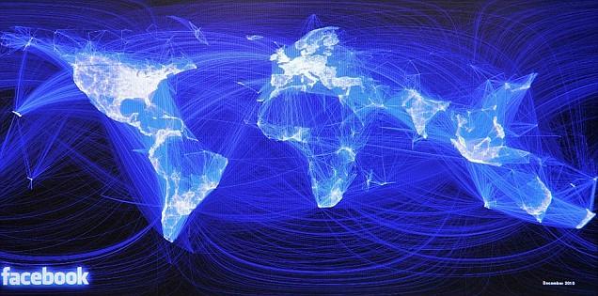
Further Motivation
Uses of arrival order information
Financial transaction networks: flow of capital
Spread of infectious diseases: origin and initial carriers
Social networks: spread of information
Network of biochemical reactions: (protein-protein interaction network)
study of the phylogenetic tree
Cancer proteins tend to be ancient proteins
[Srivastava et al., Nature 2010]
Ebola spread network
[Saey, ScienceNews Dec 2015]

Slide 6
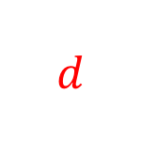
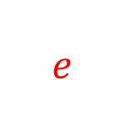

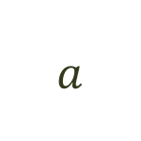
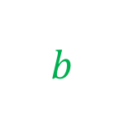
Motivation (contd.)
$$a$$
Informal problem statement is simple!
$$b$$
$$c$$
Problem is involved.
$$d$$
$$e$$
Symmetries inherent in
graphs and the models that generate them
Multiple node orderings with equal likelihood
Characterize the symmetries and establish limits on inference

Slide 7
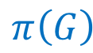

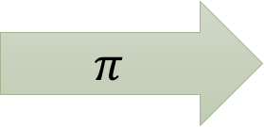
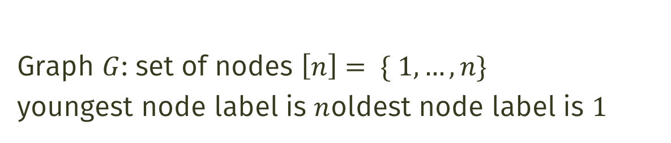
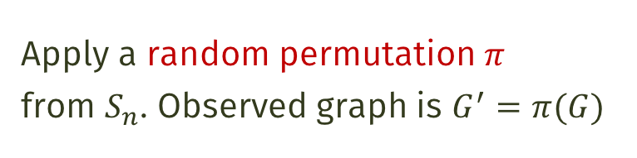

Formulation of the Problem
Graph $G$: set of nodes $\left[n\right]= \{ 1,…,n\}$
youngest node label is $n$oldest node label is $1$
3
1
10
2
8
1
4
3
$$π$$
9
5
6
9
5
6
4
11
7
8
11
7
$$G$$
Apply a random permutation $π$
from $S_{n}$. Observed graph is $G^{′}=π(G)$
12
2
$$π\left(G\right)$$
12
10
Symmetric group on $n$ letters

Slide 8
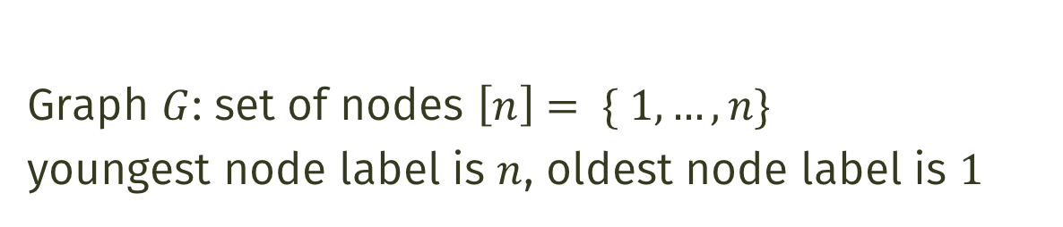



Formulation of the Problem
Graph $G$: set of nodes $\left[n\right]= \{ 1,…,n\}$
youngest node label is $n$, oldest node label is $1$
Apply a random permutation $π$ from $S_{n}$
Observed graph is $G^{′}=π(G)$
Symmetric group on $n$ letters
Aim: Infer arrival order in $G$ after observing $π(G)$
Find $π^{−1}$
Notes:
The permutation $\pi^{-1}$ can be considered the true arrival orderof the nodes of the given graph; that is, $\pi^{-1}(u)$ for a node $u$ in $G'$ gives the arrival time of that node in theoriginal graph process.

Slide 9

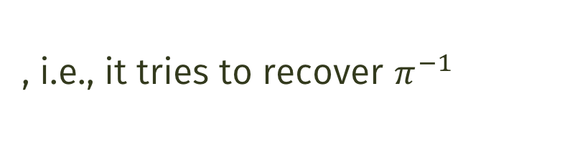

Formulation of the Problem (contd.)
A node age recovery problem is a tuple
Distortion measure between permutations
Random graph model
Node age estimator is a function
Random adversary function
, i.e., it tries to recover $π^{−1}$
Set of graphs on $n$ vertices
Symmetry group on $n$ letters
Minimax risk for a random graph model and a distortion measure
Distortion measure
Relabeled graph
Random graph model
Adversary distribution
Estimator

Slide 10


Lower Bounds on Minmax Risk
Sets of permutations associated with a random graph model
Automorphism group of the random graph $G$ distributed according to
Random graph model
Set of feasible permutations
Set of permutations $σ$ such that $σ(G)$ has positive probability under the distribution
Set of admissible graphs

Slide 11
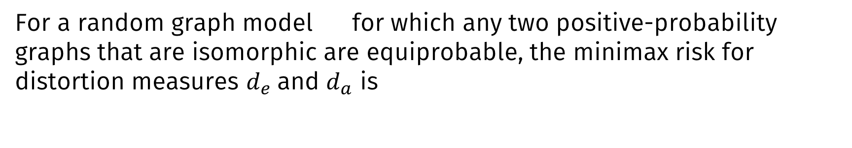
Lower Bounds on Minmax Risk (contd.)
Exact recovery
Approximate recovery
(Kendall Tau distance)
Theorem
For a random graph model for which any two positive-probability graphs that are isomorphic are equiprobable, the minimax risk for distortion measures $d_{e}$and $d_{a}$ is
Set of admissible graphs
Set of feasible permutations

Slide 12
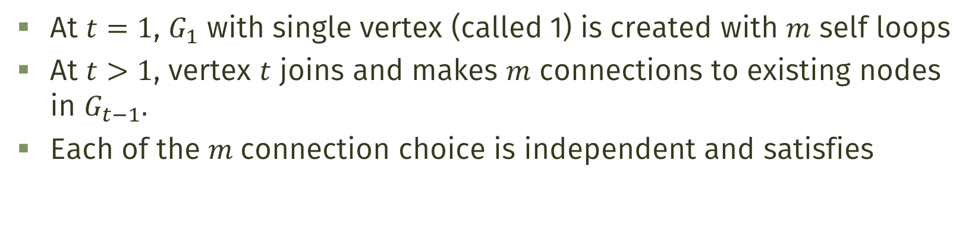
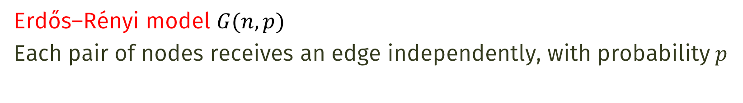
Erdős–Rényi and Preferential Attachment models
Erdős–Rényi model $G(n,p)$
Each pair of nodes receives an edge independently, with probability $p$
Preferential Attachment model
At $t=1$, $G_{1}$ with single vertex (called 1) is created with $m$ self loops
At $t>1$, vertex $t$ joins and makes $m$ connections to existing nodes in $G_{t−1}.$
Each of the $m$connection choice is independent and satisfies

Slide 13
Bad News!
Inapproximability result for Erdős–Rényi and preferential attachment graphs

Slide 14
Further Bad News!!
ML estimation is not a good approach
The maximum likelihood estimation solution set satisfies
with high probability.

Slide 15
Can we do better?

Slide 16
Partial Orders and Binning
Look for partial orders instead of total orders
Bin 1
Bin 2
Bin 3
Bin 4
Bin 5
2
8
9
10
11
1
3
5
4
7
6
12

Slide 17
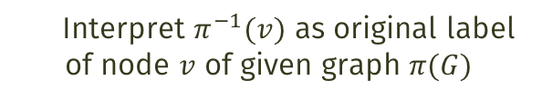
Precision and Recall
Recall:
Interpret $π^{−1}(v)$ as original label of node $v$ of given graph $π(G)$
How much we are able to recover?
# of correct pairs
Precision:
How good are the guessed pairs?
# of pairs ordered by bins (excluding those inside bins)

Slide 18

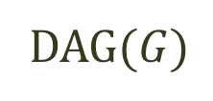
DAG(G) and its Recovery
$$G$$
DAG$(G)$
DAG$(G)$ is the graph with directions remembered

Slide 19

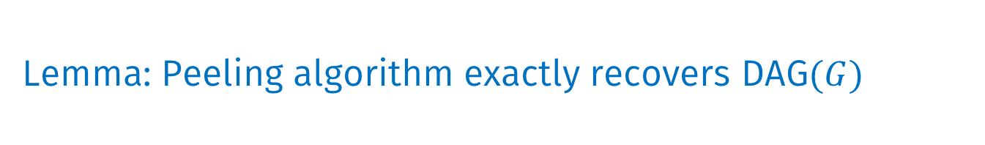
Peeling Algorithm
$$G$$
Find the minimum degree in the present graph
Put nodes with minimum degree in a bin
Remove those nodes from the graph
Repeat process 1-3 until the graph is empty
Bin 1
Bin 2
Bin 3
Bin 4
Bin 5
DAG$(G)$
2
8
9
10
11
1
3
5
4
7
6
12
Last removed is in bin 1 (guess of oldest nodes)
Lemma: Peeling algorithm exactly recovers DAG$(G)$

Slide 20
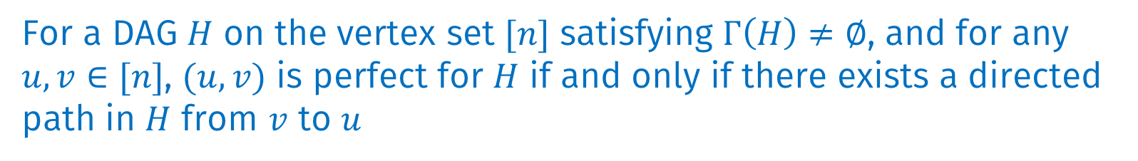
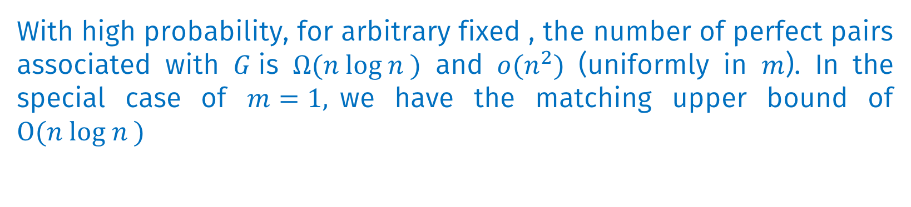
Theoretical Results
Perfect pair
$(u,v)$ is a perfect pair for a graph $H$, if for uniformly random permutation $π$,
Theorem: DAG$(G)$ captures perfect vertex pair information
For a DAG $H$ on the vertex set $[n]$ satisfying $Γ\left(H\right)≠∅$, and for any $u,v∈[n]$, $(u,v)$ is perfect for $H$ if and only if there exists a directed path in $H$ from $v$ to $u$
Theorem: Typical number of perfect pairs
With high probability, for arbitrary fixed , the number of perfect pairs associated with $G$is $Ω(n log n )$ and $o(n^{2})$ (uniformly in $m$). In the special case of $m=1,$we have the matching upper bound of $O(n log n )$

Slide 21
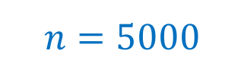
How Good is the Algorithm for Synthetic Graphs?
$$n=5000$$
: Ranking with bins given by Peeling algorithm
How robust is the algorithm?
Uniform
Attachment
model

Slide 22

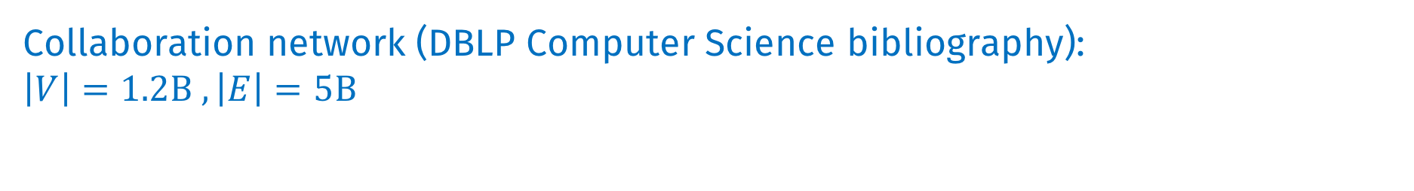

Experimental Results on Real-World Networks
Citation network (ArXiv High Energy Physics): $\left|V\right|=7.5$K$, \left|E\right|=116$M
Simple English Wikipedia: $\left|V\right|=100$K$, \left|E\right|=1.6B$
Collaboration network (DBLP Computer Science bibliography):
$\left|V\right|=1.2B , \left|E\right|=5B$
: Perfect pairs only (nodes with a directed path between them)

Slide 23
Summary
Fundamental limits are derived for inference of node arrival order in dynamic networks.
Recovery of partial orders shows promising results
We are excited!
To know that there is some hidden information to be explored apart from probability 1 orderings
To extend to some more relevant models like vertex copying model
To test in protein-protein interaction networks to find out ancestral proteins

Slide 24
Thank You!

Slide 25
Extra slides

Slide 26
Optimization of Bins

Slide 29
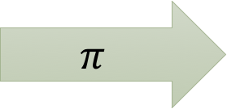
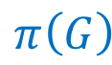

Formulation of the Problem
Graph $G$: set of nodes $\left[n\right]= \{ 1,…,n\}$
youngest node label is $n$, oldest node label is $1$
Apply a random permutation $π$ from $S_{n}$
Observed graph is $G^{′}=π(G)$
Symmetric group on $n$ letters
3
10
$$π$$
8
1
4
$$G$$
$$π\left(G\right)$$
2
Notes:
The permutation $\pi^{-1}$ can be considered the true arrival orderof the nodes of the given graph; that is, $\pi^{-1}(u)$ for a node $u$ in $G'$ gives the arrival time of that node in theoriginal graph process.

